Slide 1
Loops in R

Slide 2
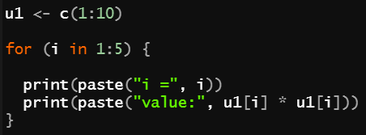
What is Loop
An special construct that allow repetition of instructions or blocks of instructions
for loop example:
for ( iterator in collection ) {
action to run repeatedly
}

Slide 3
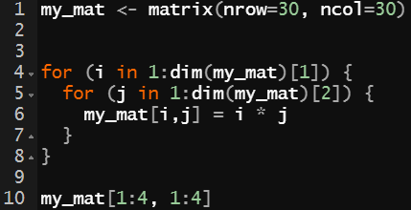
Nested Loop
A loop can be placed inside another loop.
Question: How many times does line 6 be executed?
(2 points)
Question: return value of line 10?
(2 points)

Slide 4
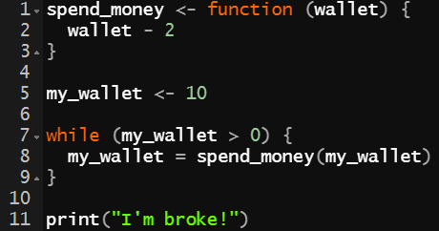

While
while loop is another structure of loop.
while ( logical expression ) {
action to run repeatedly
}
Question: What will happen in the following code section?
(4 points)

Slide 5
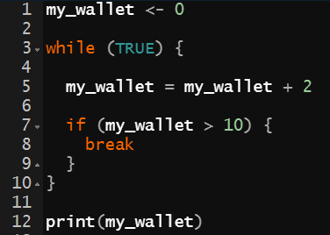
break Statement in Loop
When the R interpreter encounters a break, it will pass control to the instruction immediately after the end of the loop.
Question: return value of line 12?
(2 points)

Slide 6
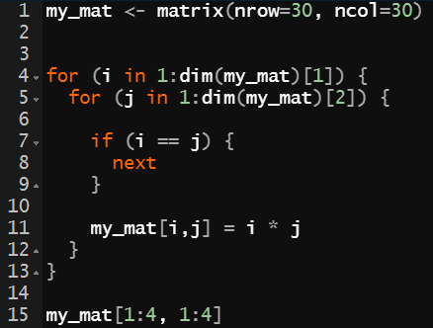
next Statement in Loop
next discontinues a current iteration and jumps to the next cycle. It has the same meaning as continue or skip in other languages.
Question: return value of line 15?
(4 points)

Slide 7
Recursion

Slide 8
What is Recursion
A function that calls itself is called a recursive function and this technique is known as recursion.
This special programming technique can be used to solve problems by breaking them into smaller and simpler sub-problems.
Example: Finding the factorial of a number
5! = 1*2*3*4*5 = 120
5! = 5 * 4!
4! = 4 * 3!
3! = 3 * 2!
。。。

Slide 9
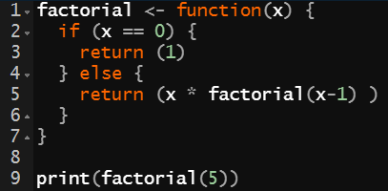
Factorial Recursive Function
Question: Try to explain the following recursion.
(6 points)
5! = 5 * 4!
4! = 4 * 3!
3! = 3 * 2!
。。。

Slide 10
Recursion / Iteration
Recursion and iteration are mutually convertible!
Question: Rewrite the recursive function using for loop.
(10 points)
Recursion
Iteration
?

Slide 11
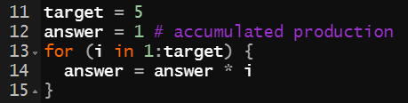
Recursion / Iteration
Recursion and iteration are mutually convertible!
Recursion
Iteration

Slide 12
Vectorization

Slide 13
Vectorized Operations
A key difference between R and other languages is concept of vectorization.
For example, When you want to get total of a vector :
Using Vectorization.
Using Loop
a <- 1: 10
sum(a)
a <- 1: 10
total <- 0
for (i in a) { total = total + I }
Vectorized operation implemented in C. Much faster!
Many of R’s functions work this way; the loop is hidden from you in C.

Slide 14



Vector Recycling
What are the results of following code? Why?
(1)
(2)
(3)
(2 points)
(4 points)
(4 points)

Slide 15
Vector Recycling (Cont.)
When performing vector operations in R, it is important to know about recycling.
If you perform an operation on two or more vectors of unequal length, R will recycle elements of the shorter vector(s) to match the longest vector.
(2)
(3)
It’s a vector,
not scalar
(4 points)
(4 points)
[1, 2, 3, 4, 5, 6, 7, 8, 9, 10]
+
[1, 2, 3, 4, 5, 1, 2, 3, 4, 5]
[1, 2, 3, 4, 5, 6, 7, 8, 9, 10]
*
[7, 7 , 7 , 7 , 7 , 7 , 7 , 7 , 7 , 7]

Slide 16

Apply() function
apply() allows us to repeat a function on all of the rows or columns of a data frame.
For example:
a dataframe x
use apply() to get mean values of all columns
apply(x, 2, mean)
you can also apply your customized function!
1: do operation over rows,
2: do operation over columns

Slide 17
Performance

Slide 18
Loops in R Are Slow?
No, they are not! If you follow some golden rules:
Don’t use a loop when a vectorized alternative exists.
Don’t grow objects during loop
Allocate objects to hold results before loop
and fill it in during the loop
Question
10 points for precise explanation

Slide 19
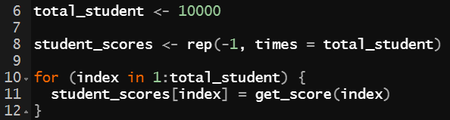
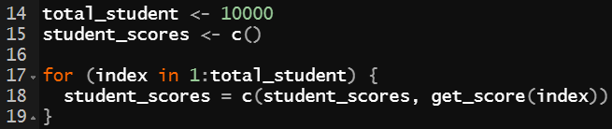
Don’t Grow Objects during Loop
Allocate objects to hold results before loop
R has to create a new object and copy across the information just to add a new element or row/column.
much faster than
Grow objects during loop

Slide 20
Reference
A Tutorial on Loops in R - Usage and Alternatives
https://www.datacamp.com/community/tutorials/tutorial-on-loops-in-r
R Recursive Function
https://www.datamentor.io/r-programming/recursion/
Loops in R
https://swcarpentry.github.io/r-novice-inflammation/15-supp-loops-in-depth/index.html
Advanced R: Memory
http://adv-r.had.co.nz/memory.html
Speed up R code: vectorization tricks
https://rpubs.com/daspringate/vectorisation

